Slide 1
Empowered Interface Diagram
Tarun Garg
Priyaa Yoganandham
Ipsha Sinha

Slide 2
Index
Opportunity Creation - [I0129, I0142]
Risk flow from CRM to S4HANA(Blocking/Unblocking) – [I0137,I0145]
BillingHubIntegration – [I0148, I0158]
e-travel – [I0103]
SideTrade – [I0126]
PaymentConfirmation – [I0003]
Coupa-Invoice – [I0006,I0007]
Customer Master – [I0083, I0105]
vendor master – [I0154, I0004]
Coupa, Kofax Integration - CostObjects – [I0001, I0157]
Coupa Integration – GL – [I0002]
Paperchase Integration – [I0021]
KGS Employee Availability – [I0057]
Partner Validation – [I0150]
Customer Account Release – [I0133]
Malta Resource Availability – [I0146]
vCard Integration – [I0161]
MSD to WorkSite Account Data – [I0159]
OneServicePortal to SF – [I0159]
Worksite - Engagement/Chargeable Code Data – [I0118, I0170]
Worksite - TM (Client) – [I0159]
Worksite - TM (Opportunity) – [I0159]
MSD to WorkSite Opportunity Data – [I0159]
JobTrack Integration – [I0022]
Audit Apps

Slide 3
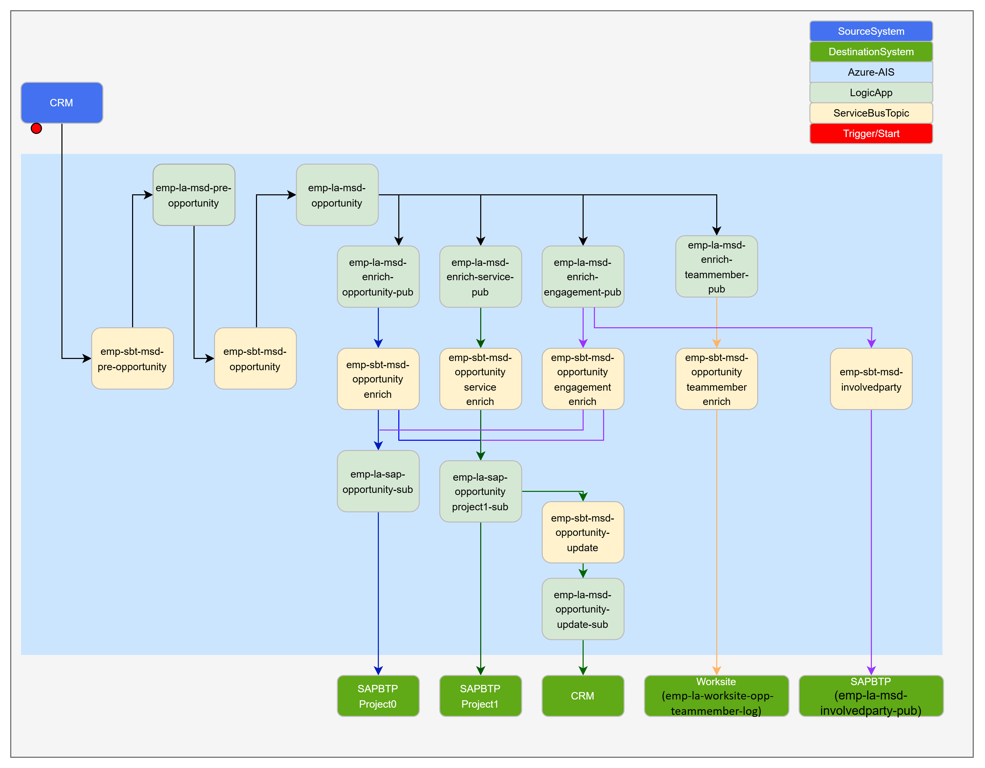
Opportunity creation – [I0129, I0142]
HLD : Conceptual Integration Design - OpportunityV7.pptx
IDD : IDDD
GIT :

Slide 4
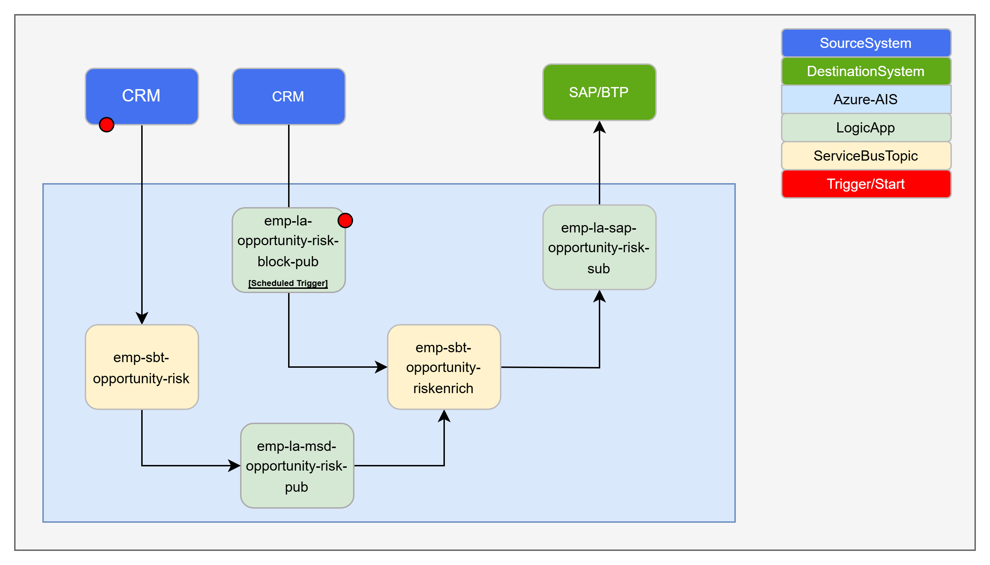
Risk flow from CRM to S4HANA(Blocking/Unblocking) – [I0137, I0145]
HLD : HLD_I0137_I0145_Risk Interface v1.2.pptx
IDD : IDDD
GIT : KPMG-UK/ewt-ais-emp-la at emp-msd-opportunity-risk

Slide 5
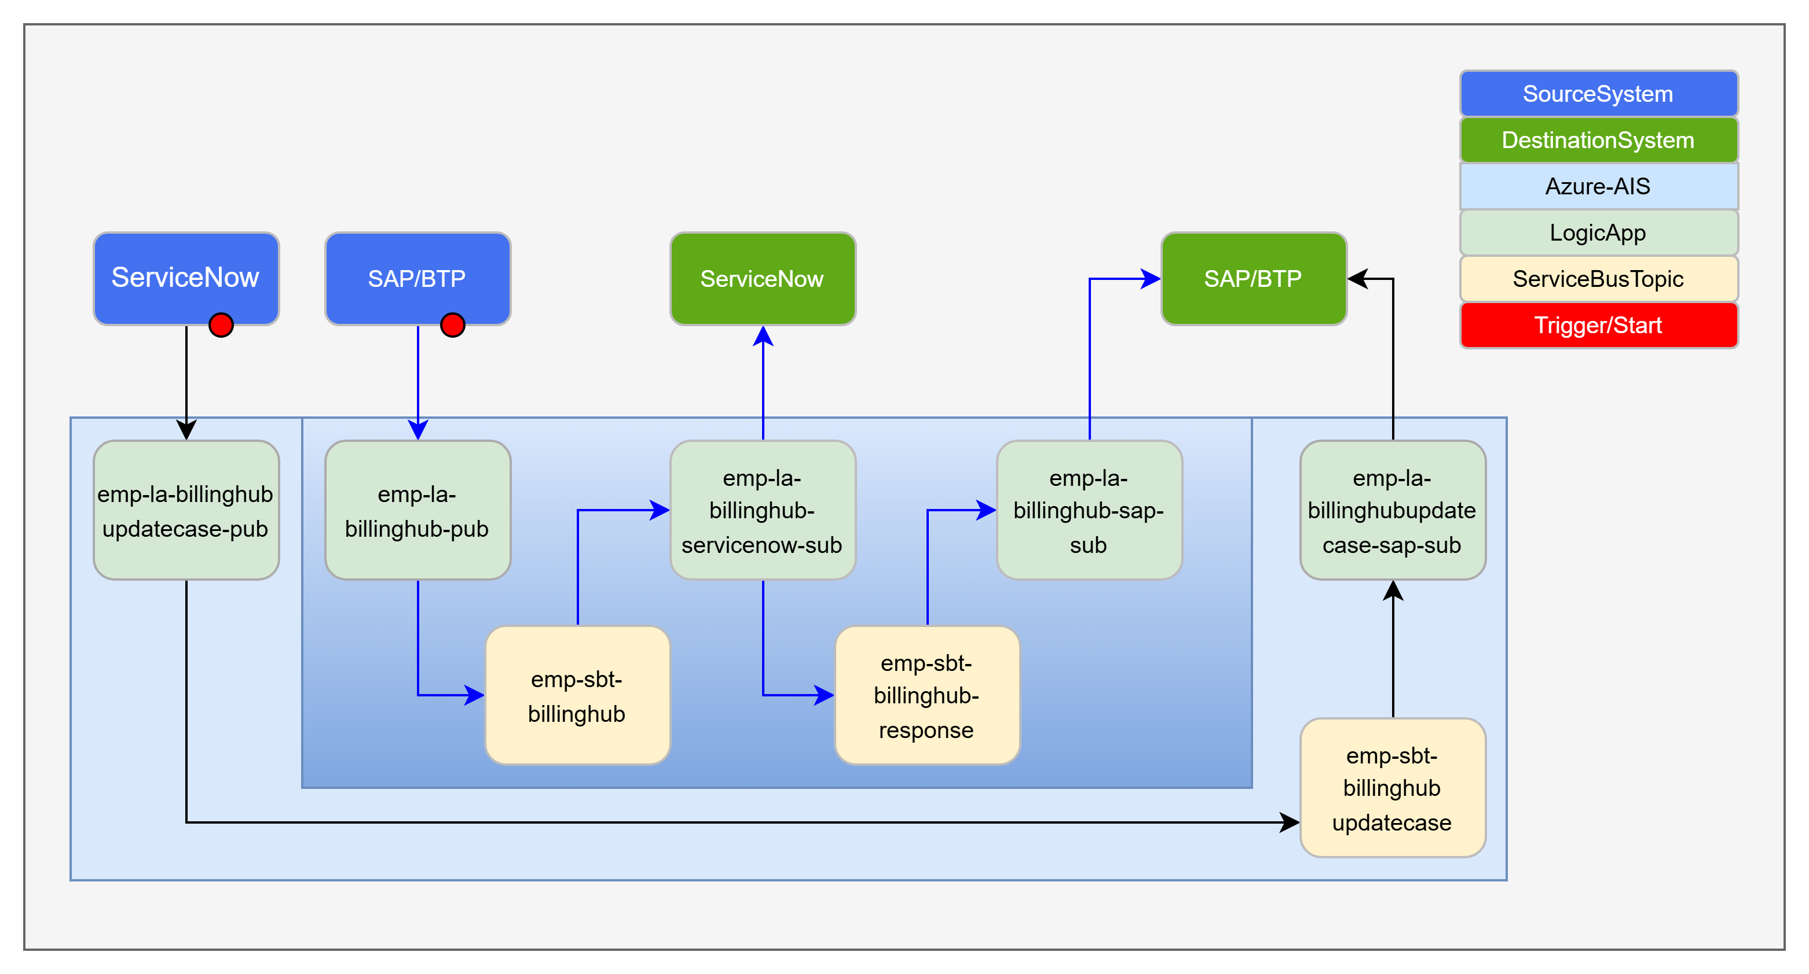
BillingHubIntegration – [I0148, I0158]
HLD : Conceptual Integration Design - Billing Interface v0.4.pptx
IDD : IDDD
GIT :

Slide 6
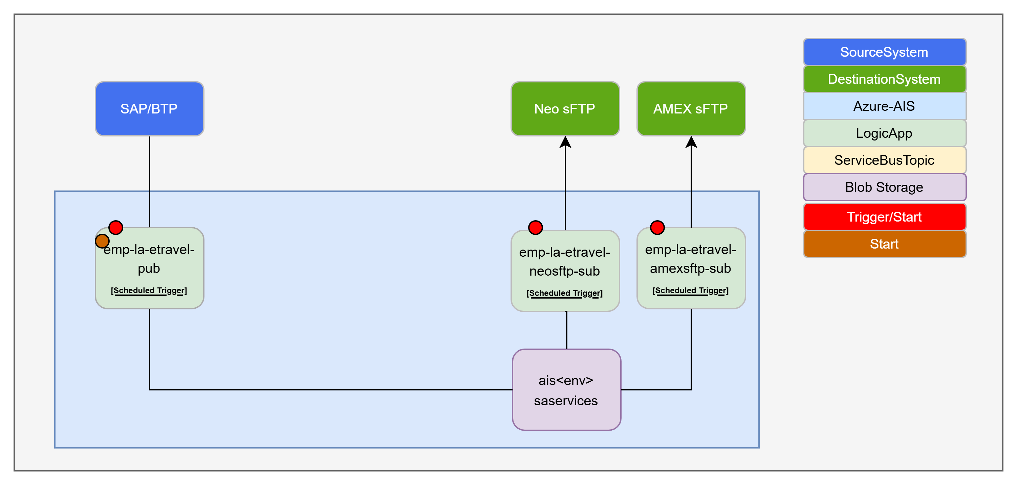
E-Travel Integration – [I0103]
HLD : Conceptual Integration Design - S4HC to eTravel.pptx
IDD : IDDD
GIT :

Slide 7
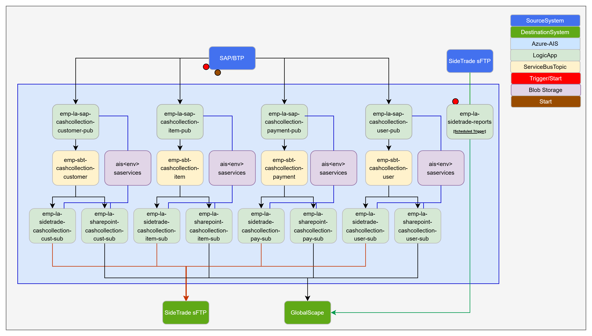
SideTrade – [I0126]
HLD : Conceptual Integration Design - SAP Credit Management Data to SideTrade.pptx
IDD : IDDD
GIT :

Slide 8
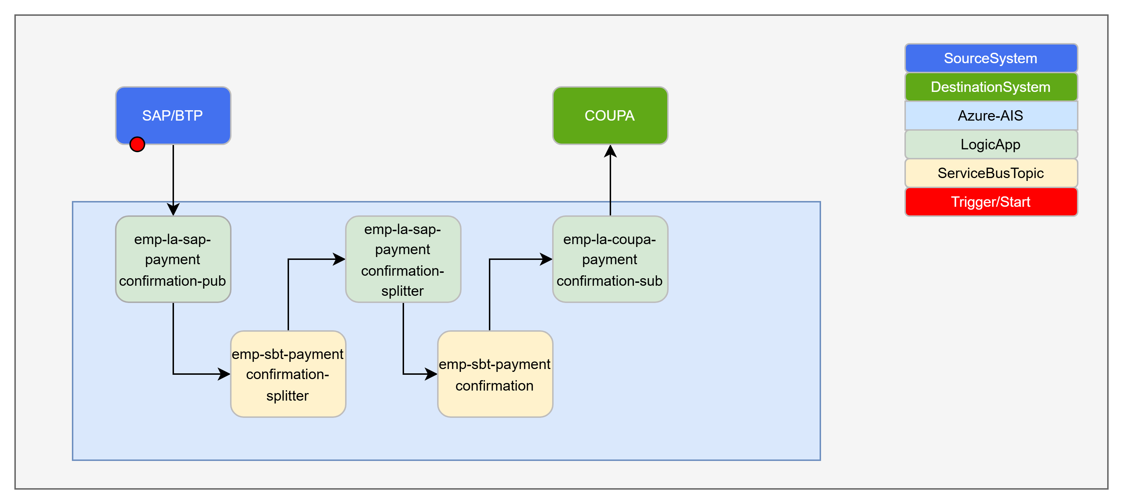
Coupa Integration – Payment Confirmation – [I0003]
HLD : Conceptual Integration Design - SAP PaymentConfirmation to Coupa.pptx
IDD : IDDD
GIT :

Slide 9
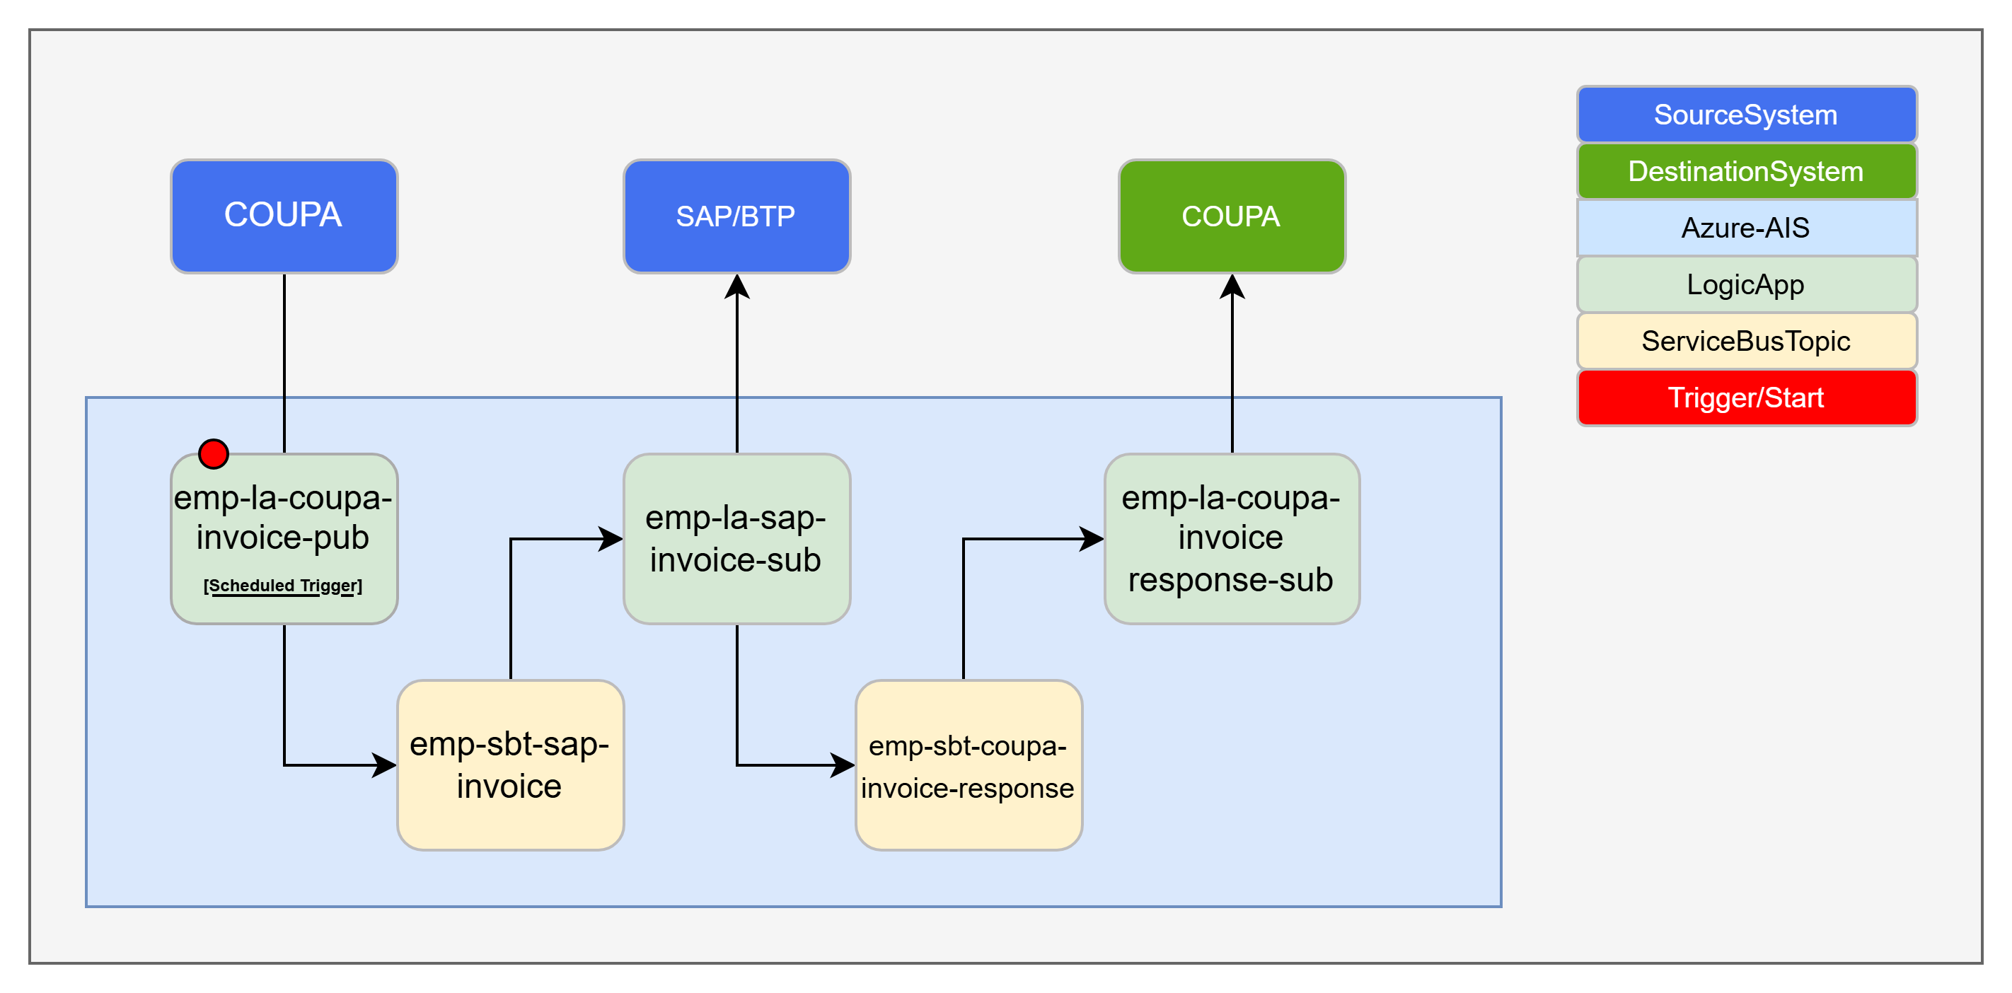
Coupa Integration – Invoice – [I0006]
HLD : Conceptual Integration Design - Coupa Invoice to SAP.pptx
IDD : IDDD
GIT :

Slide 10
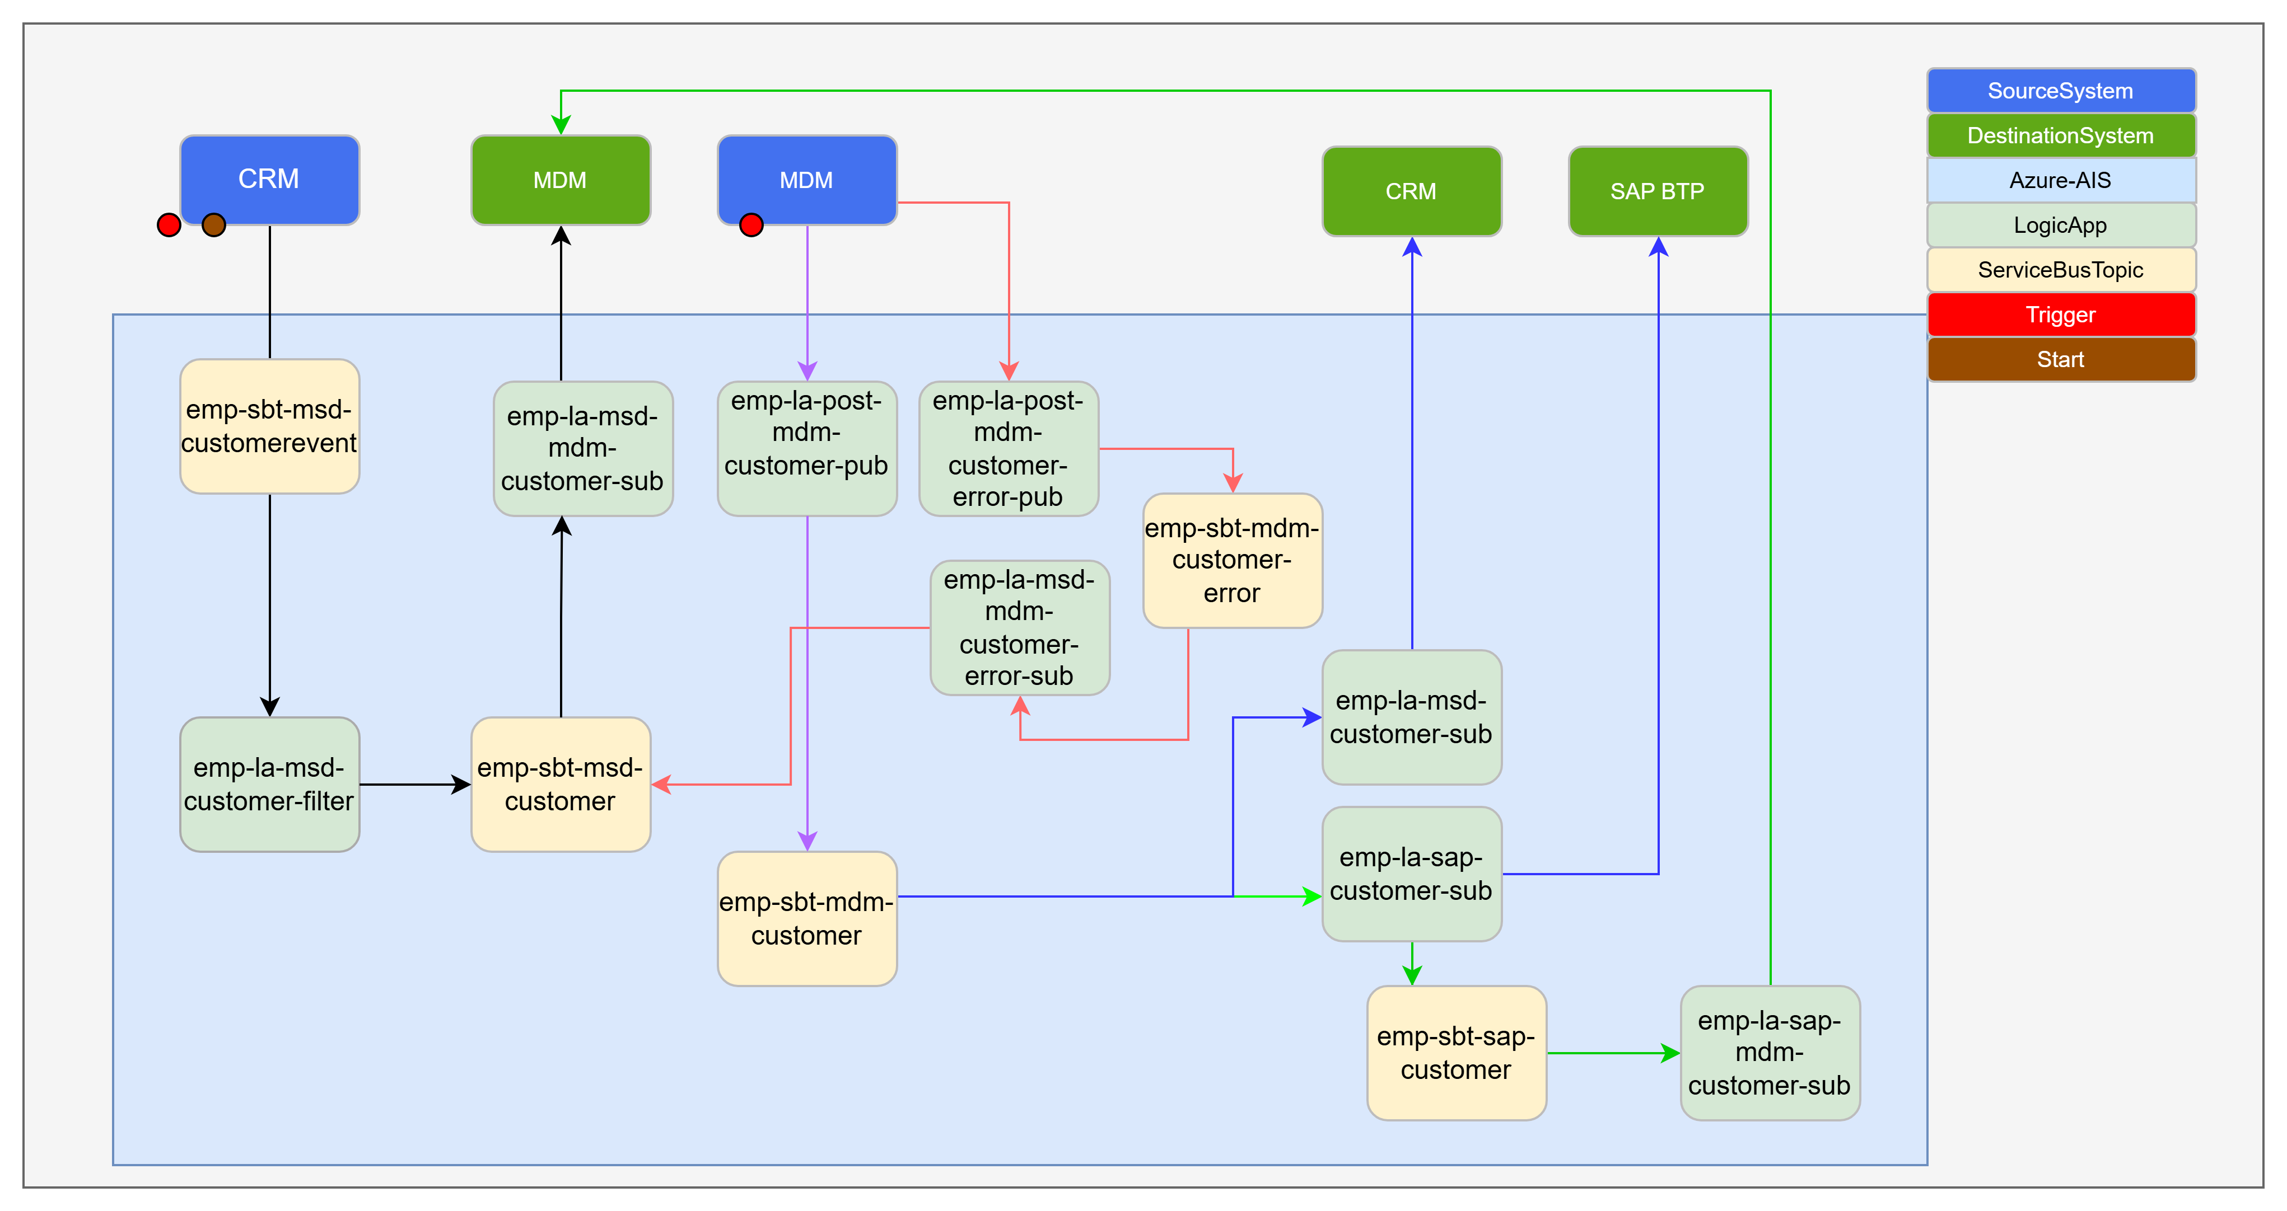
Informatica Integration – BP Customer – [I0083, I0105]
HLD : Conceptual Integration Design - Customer Master.pptx
IDD : IDDD
GIT : KPMG-UK/ewt-ais-emp-la at emp-mdm-customermaster

Slide 11
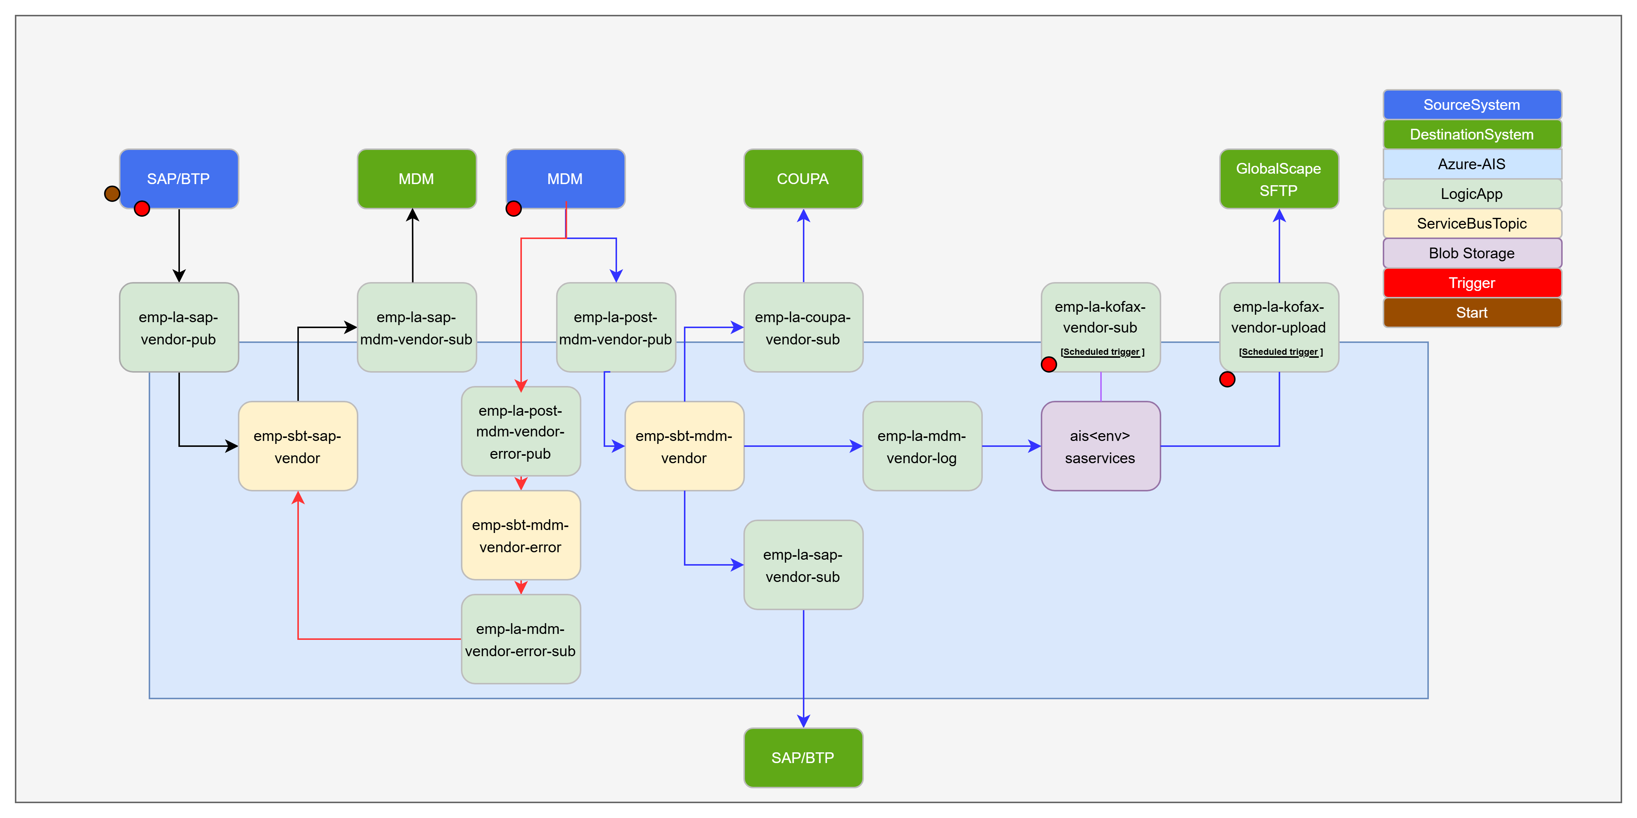
Kofax: Vendor – [I0154, I0004]
HLD : Conceptual Integration Design - Vendor Master to Kofax_Coupa.pptx
IDD : IDDD
GIT : KPMG-UK/ewt-ais-emp-la at emp-mdm-vendormaster

Slide 12
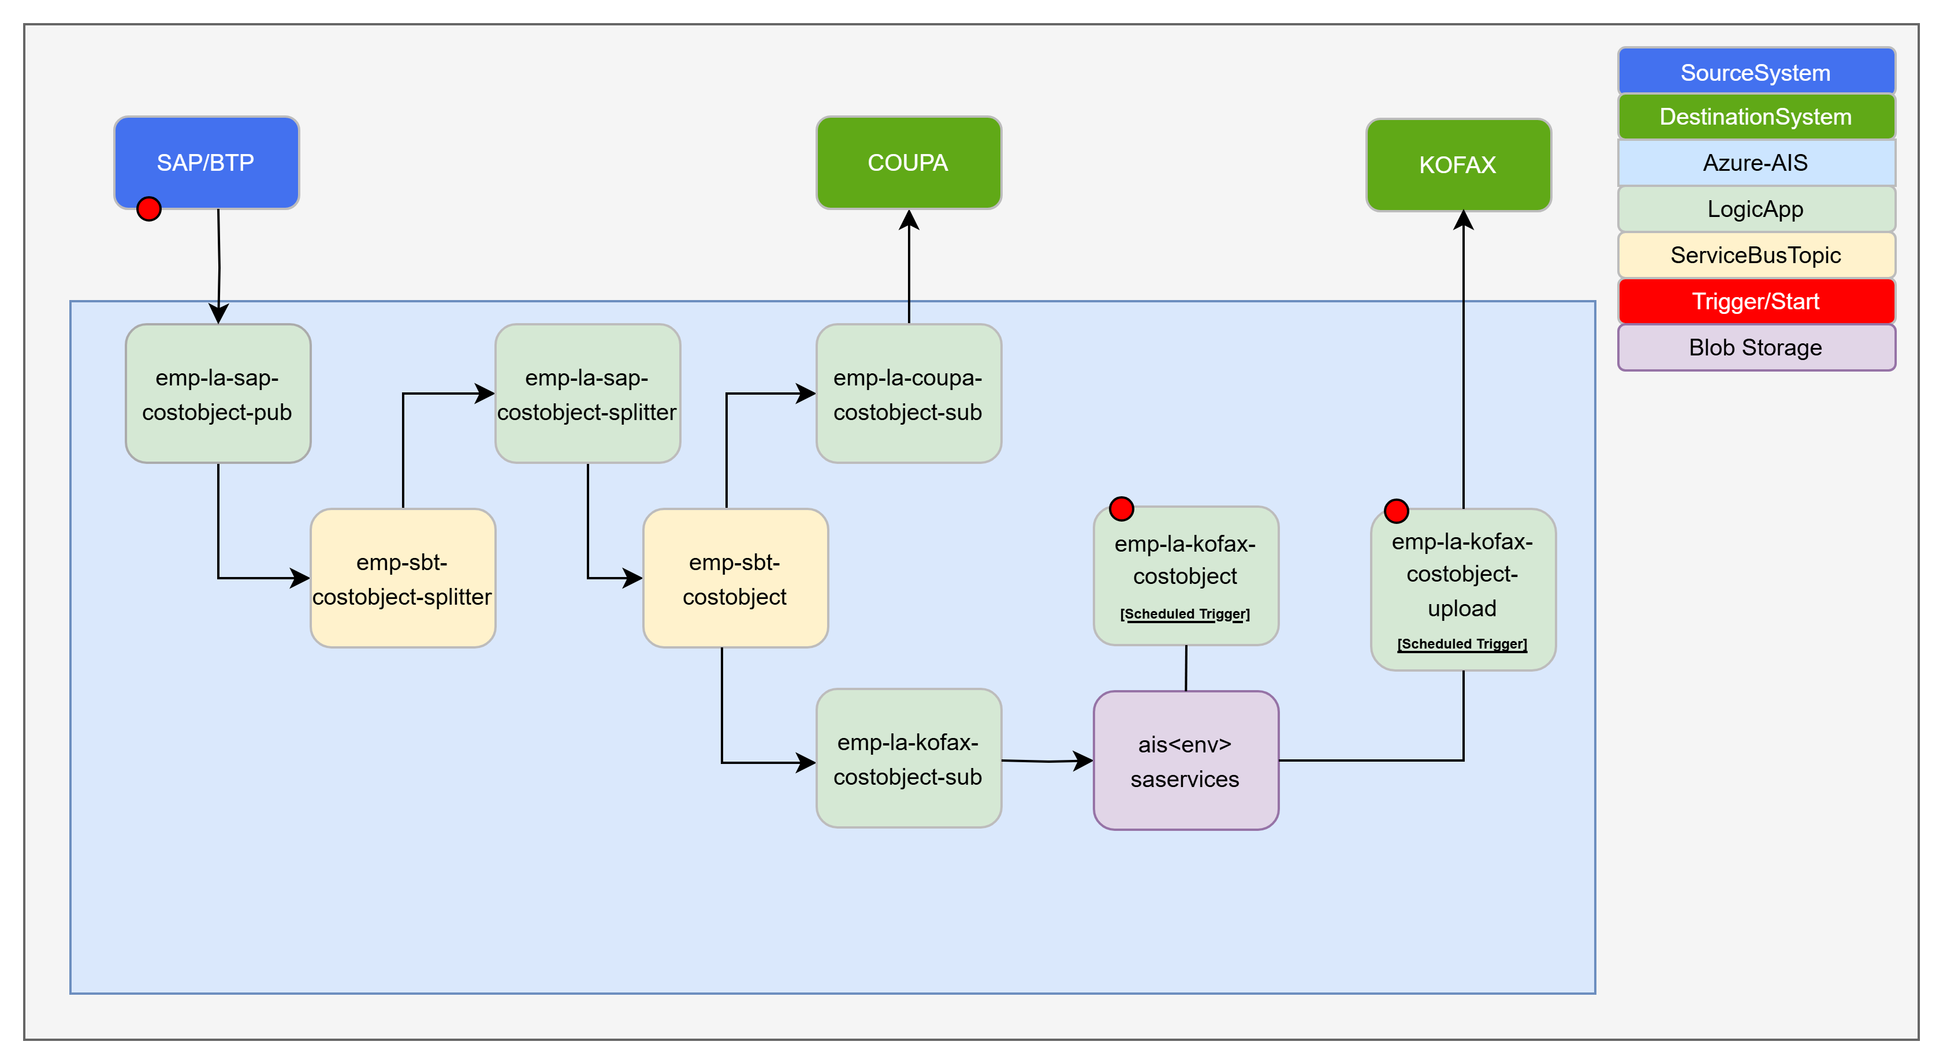
Coupa, Kofax Integration - CostObjects – [I0001, I0157]
HLD : Conceptual Integration Design - SAP Cost Object.pptx
IDD : IDDD
GIT :

Slide 13
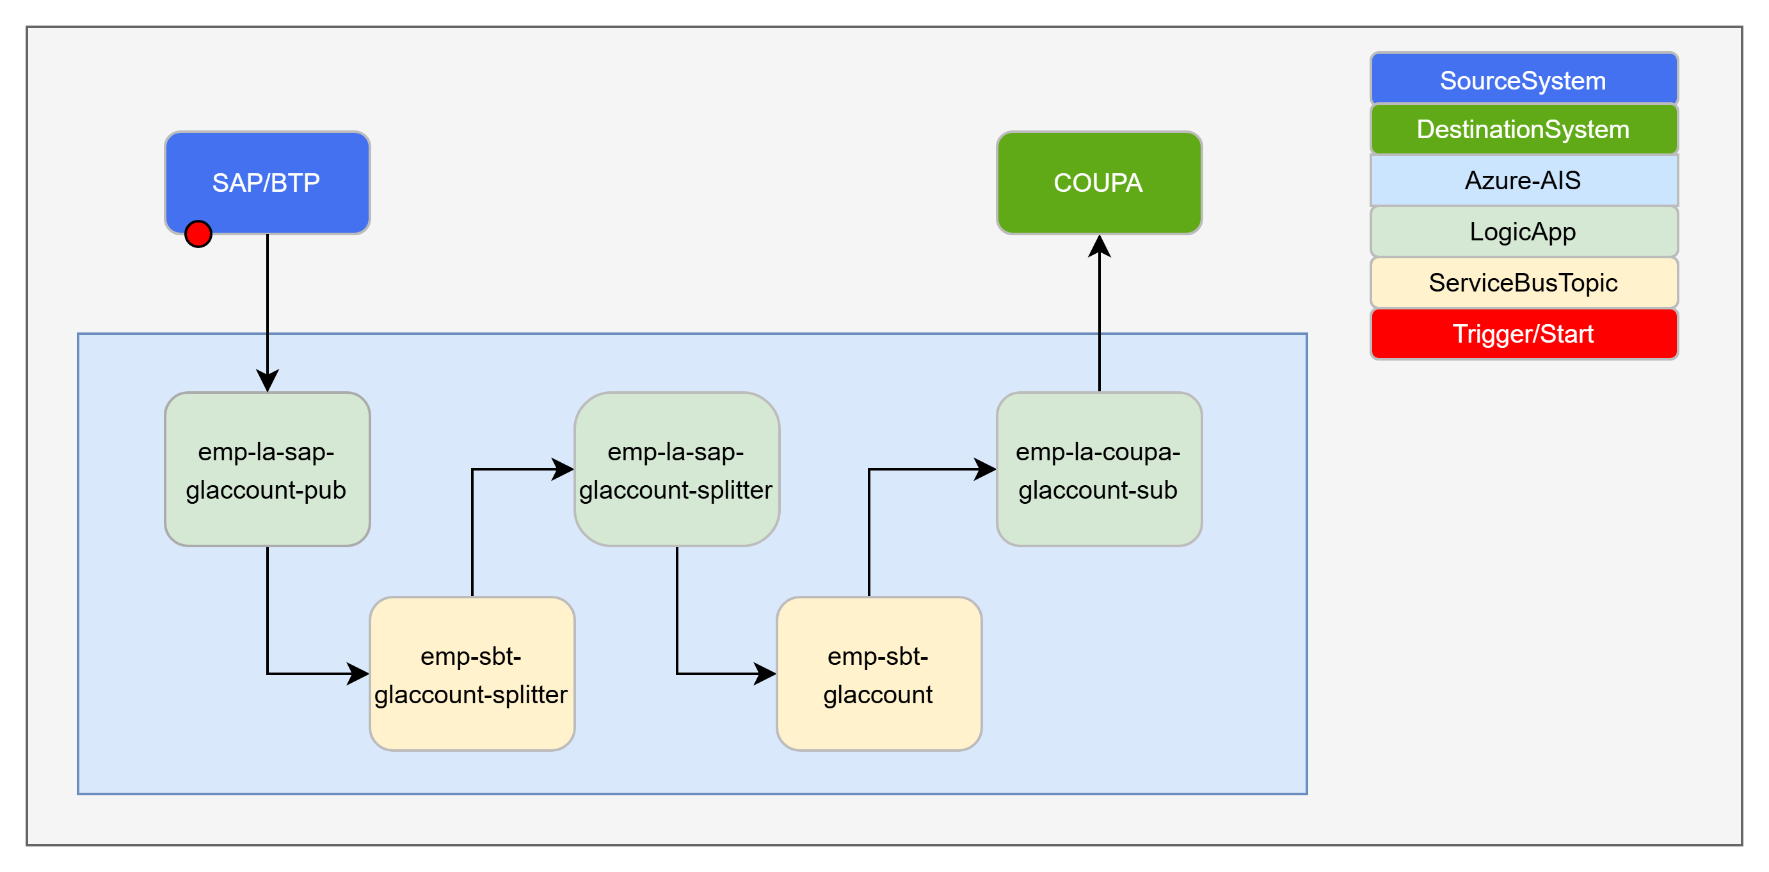
Coupa Integration – GL – [I0002]
HLD : Conceptual Integration Design - SAP GL Account to Coupa.pptx
IDD : IDDD
GIT :

Slide 14
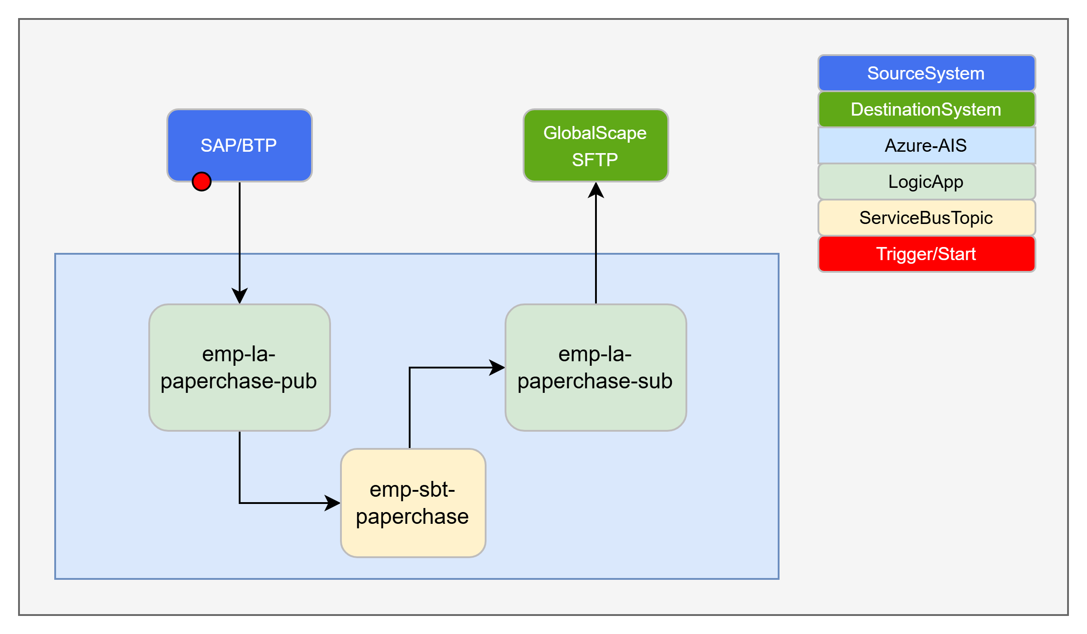
Paperchase Integration – [I0021]
HLD : Conceptual Integration Design - SAP Engagement Data to Paperchase.pptx
IDD : IDDD
GIT :

Slide 15
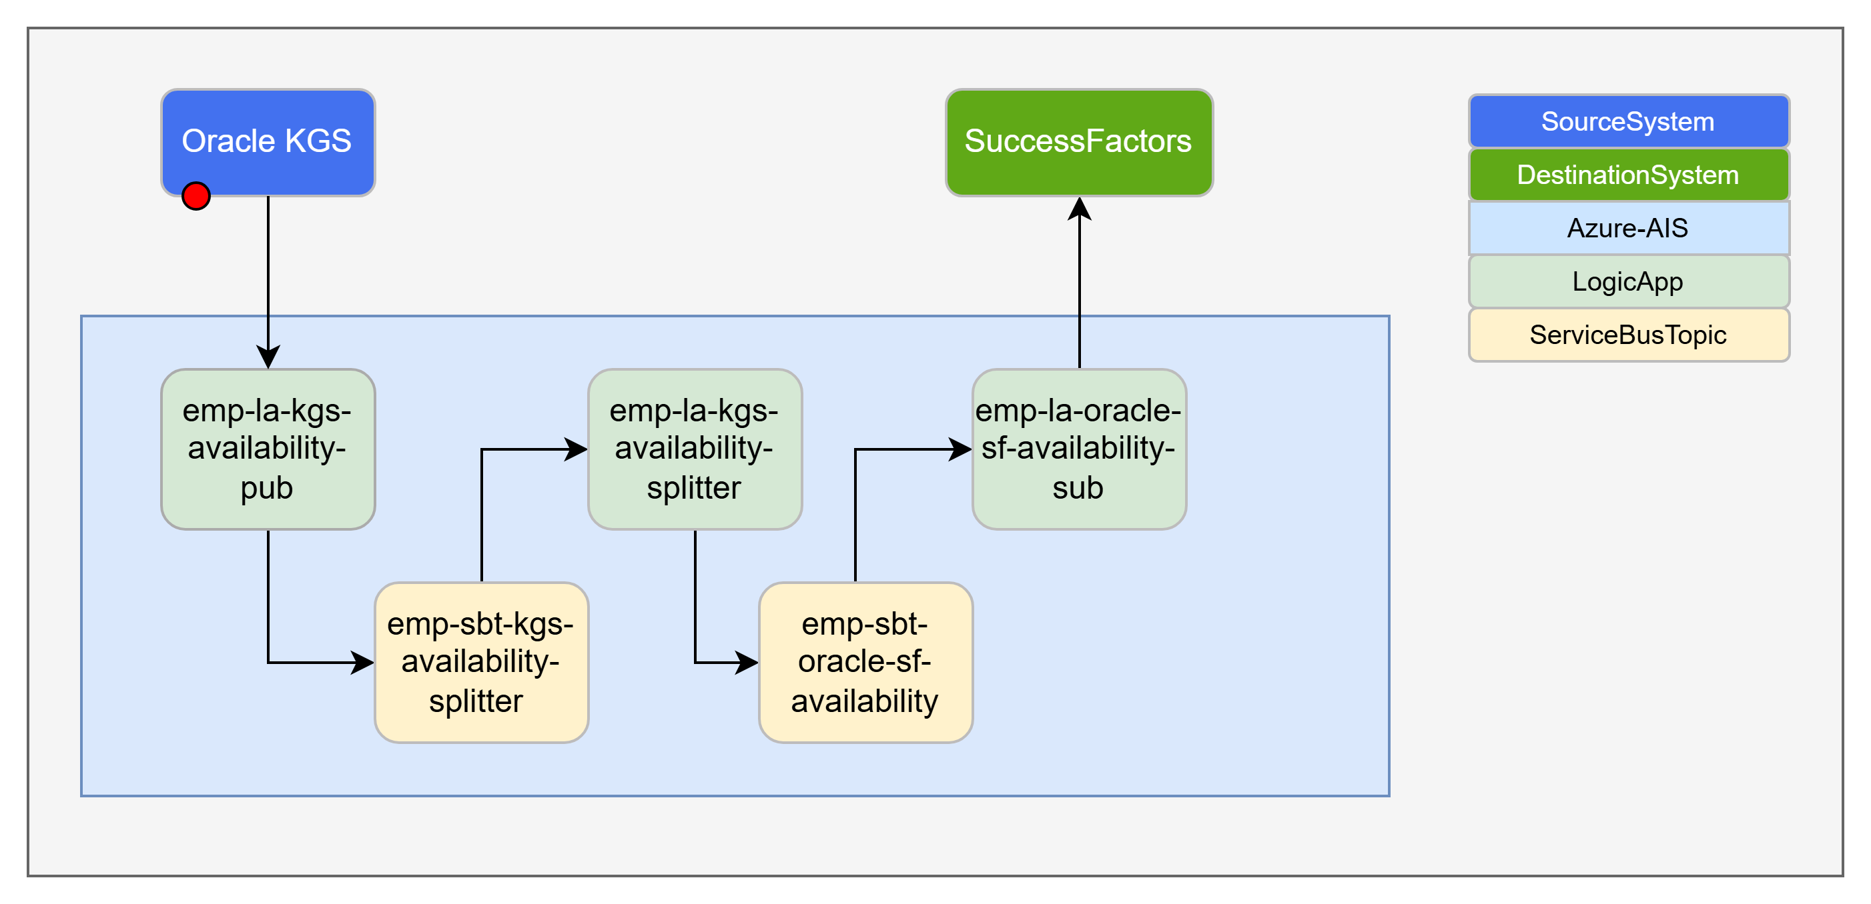
KGS Employee Availability – [I0057]
HLD : Conceptual Integration Design - Oracle KGS availability to SF.pptx
IDD : IDDD
GIT :

Slide 16
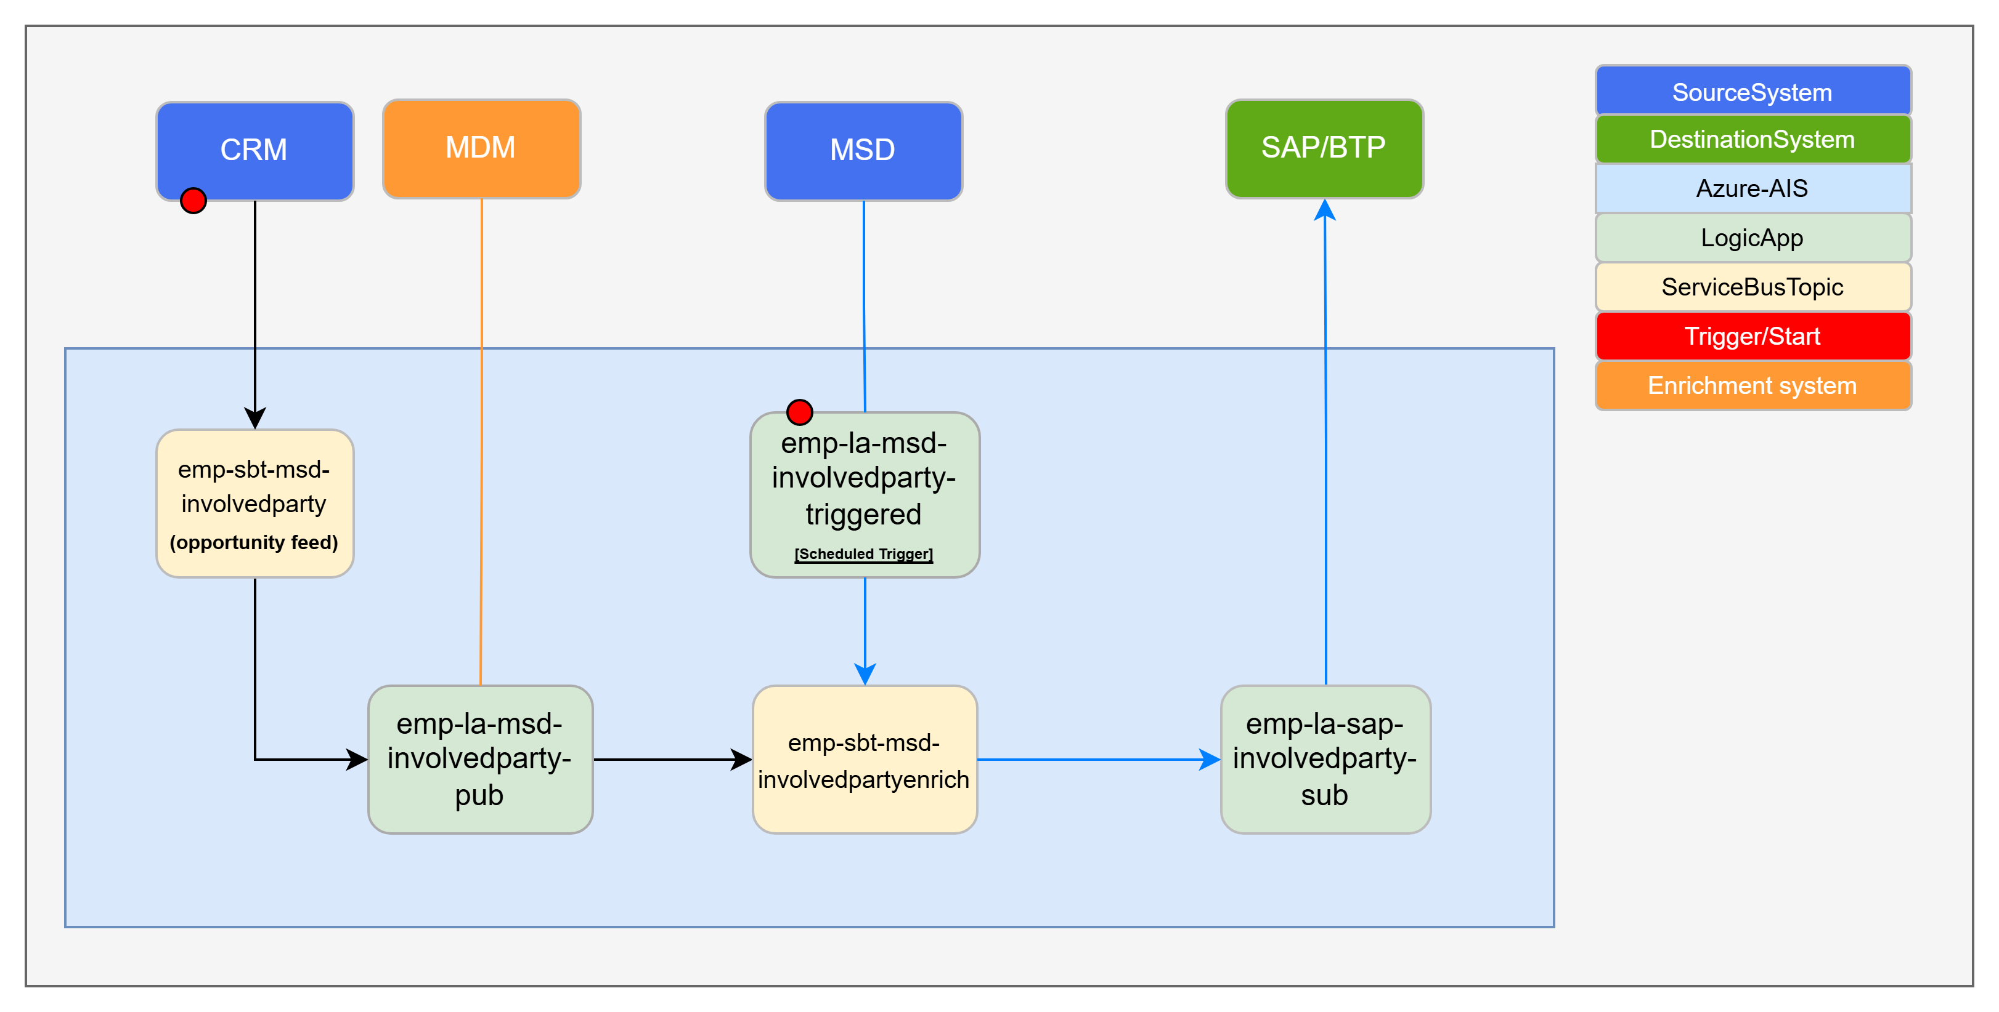
Partner Validation – [I0150]
HLD : Conceptual Integration Design - Partner Validation.pptx
IDD : IDDD
GIT :

Slide 17
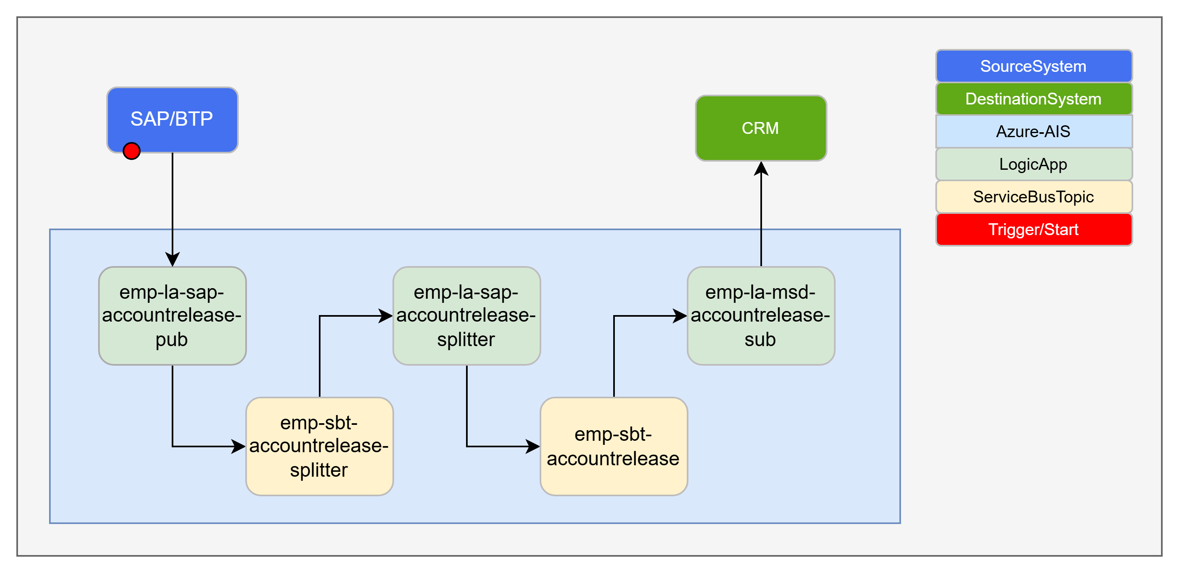
Customer Account Release – [I0133]
HLD : Conceptual Integration Design - SAP Customer Account Release to MSD.pptx
IDD : IDDD
GIT : KPMG-UK/ewt-ais-emp-la at emp-msd-customeraccountrelease

Slide 18
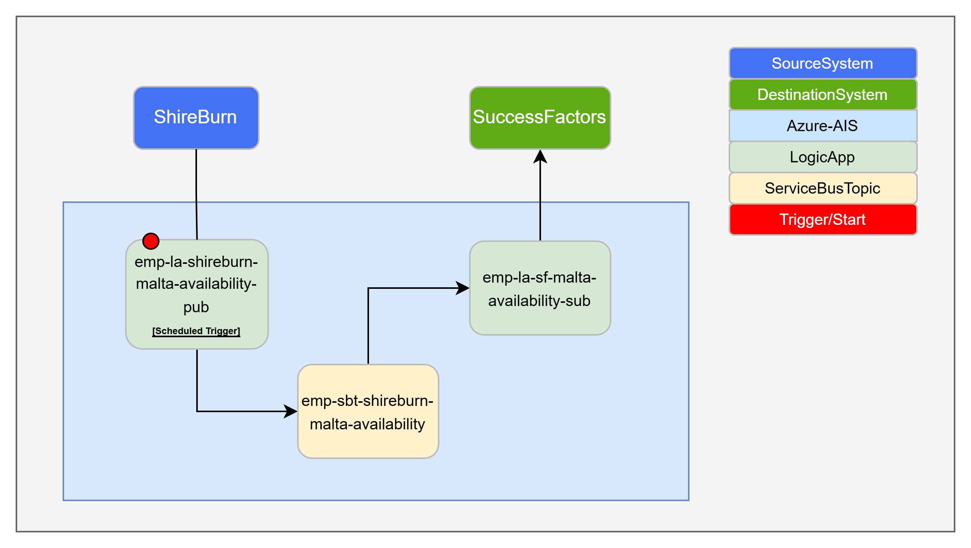
Malta Resource Availability – [I0146]
HLD : Conceptual Integration Design - Malta Availability to SF.pptx
IDD : IDDD
GIT :

Slide 19
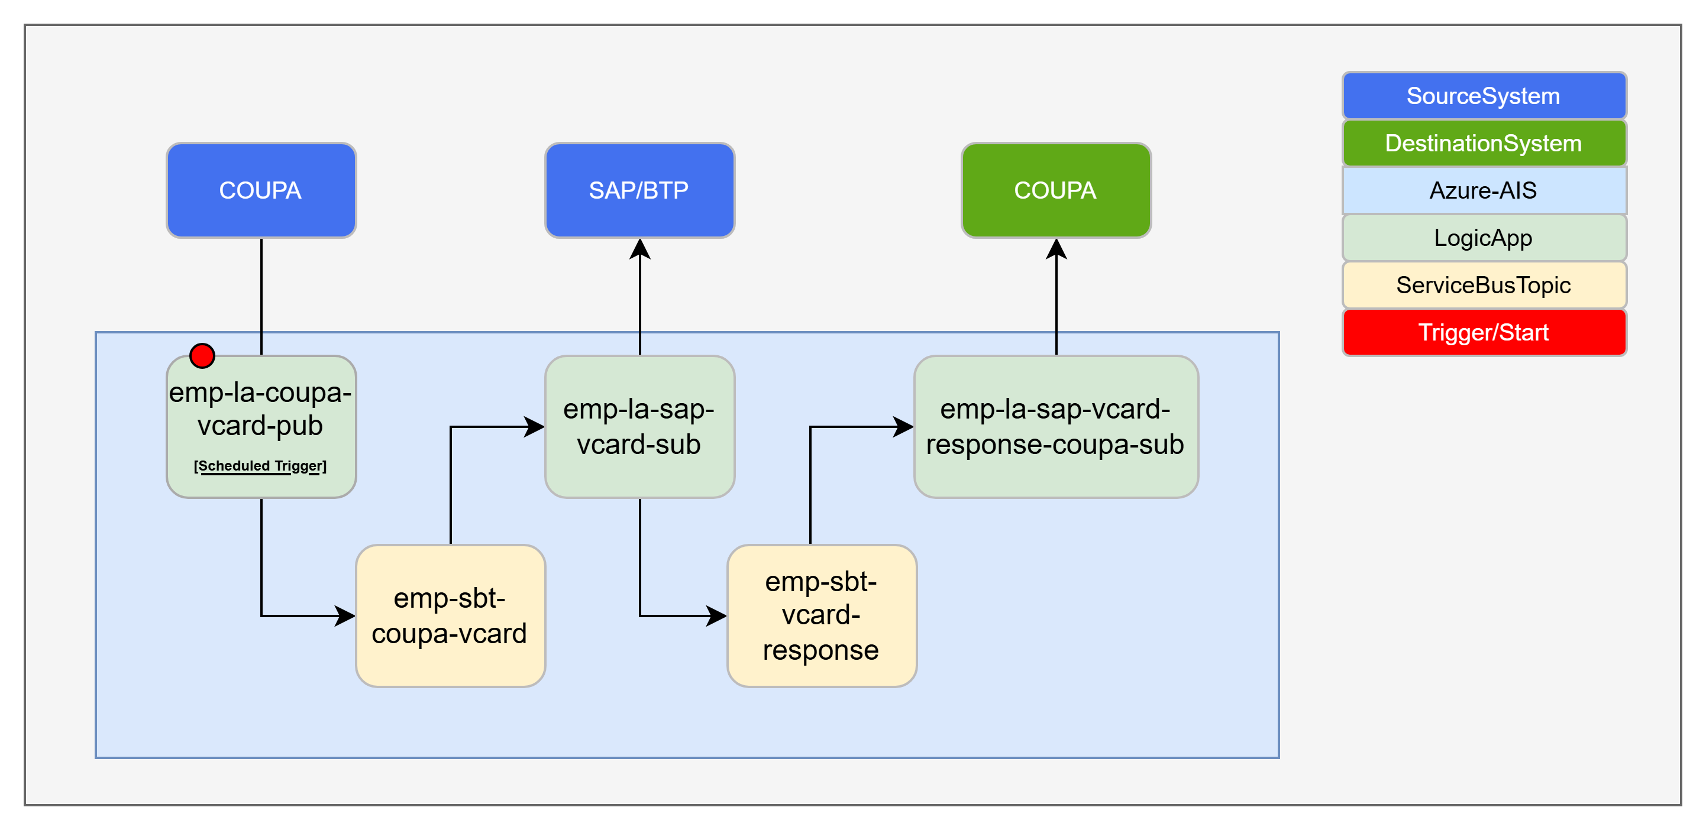
vCard Integration – [I0161]
HLD : Conceptual Integration Design - Coupa Virtual Card Statement Data to SAP.pptx
IDD : IDDD
GIT :

Slide 20
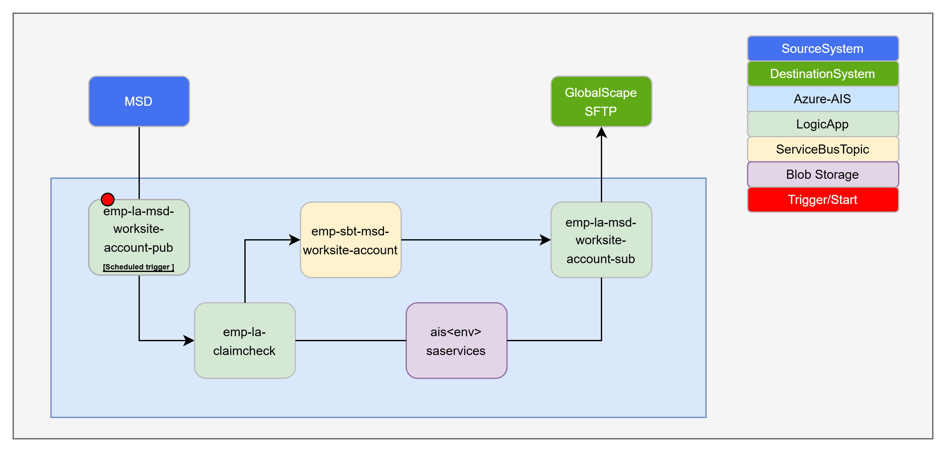
MSD to WorkSite Account Data – [I0159]
HLD : Conceptual Integration Design - MSD Team Member Data to Worksite.pptx
IDD : IDDD
GIT :

Slide 21
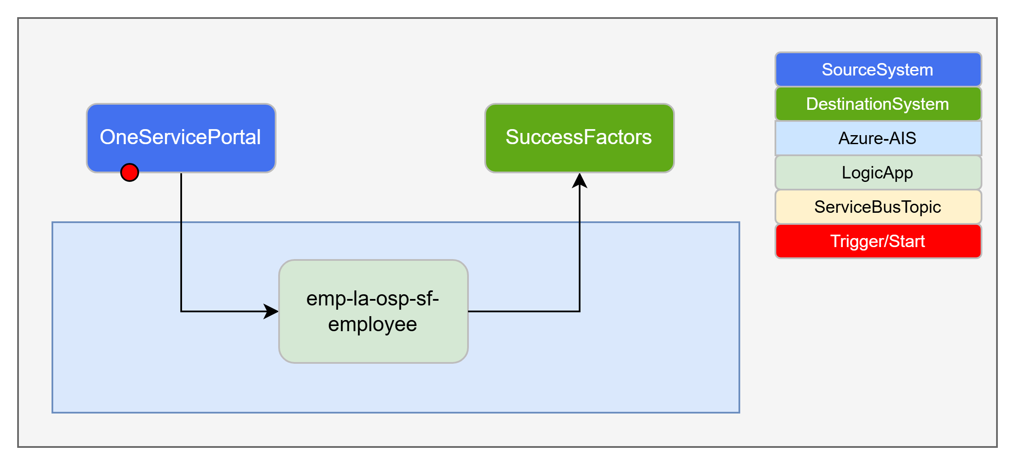
OneServicePortal to SF – [I0159]
HLD : Conceptual Integration Design - OneServicePortal to SF.pptx
IDD : IDDD
GIT :

Slide 22
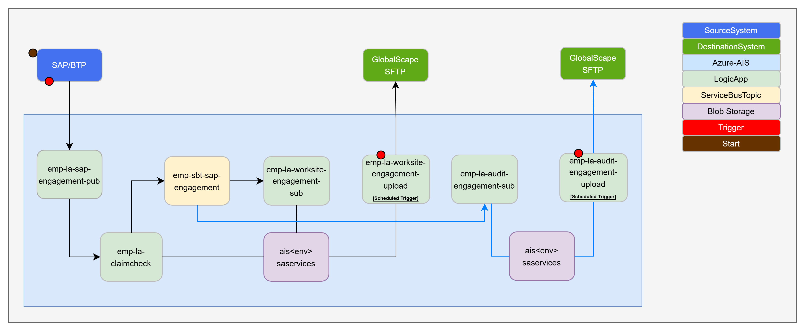
Worksite - Engagement/Chargeable Code Data – [I0118, I0170]
HLD : AIS - High Level Design Worksite Engagement Chargeable Code Data.pptx
IDD : IDDD
GIT :

Slide 23
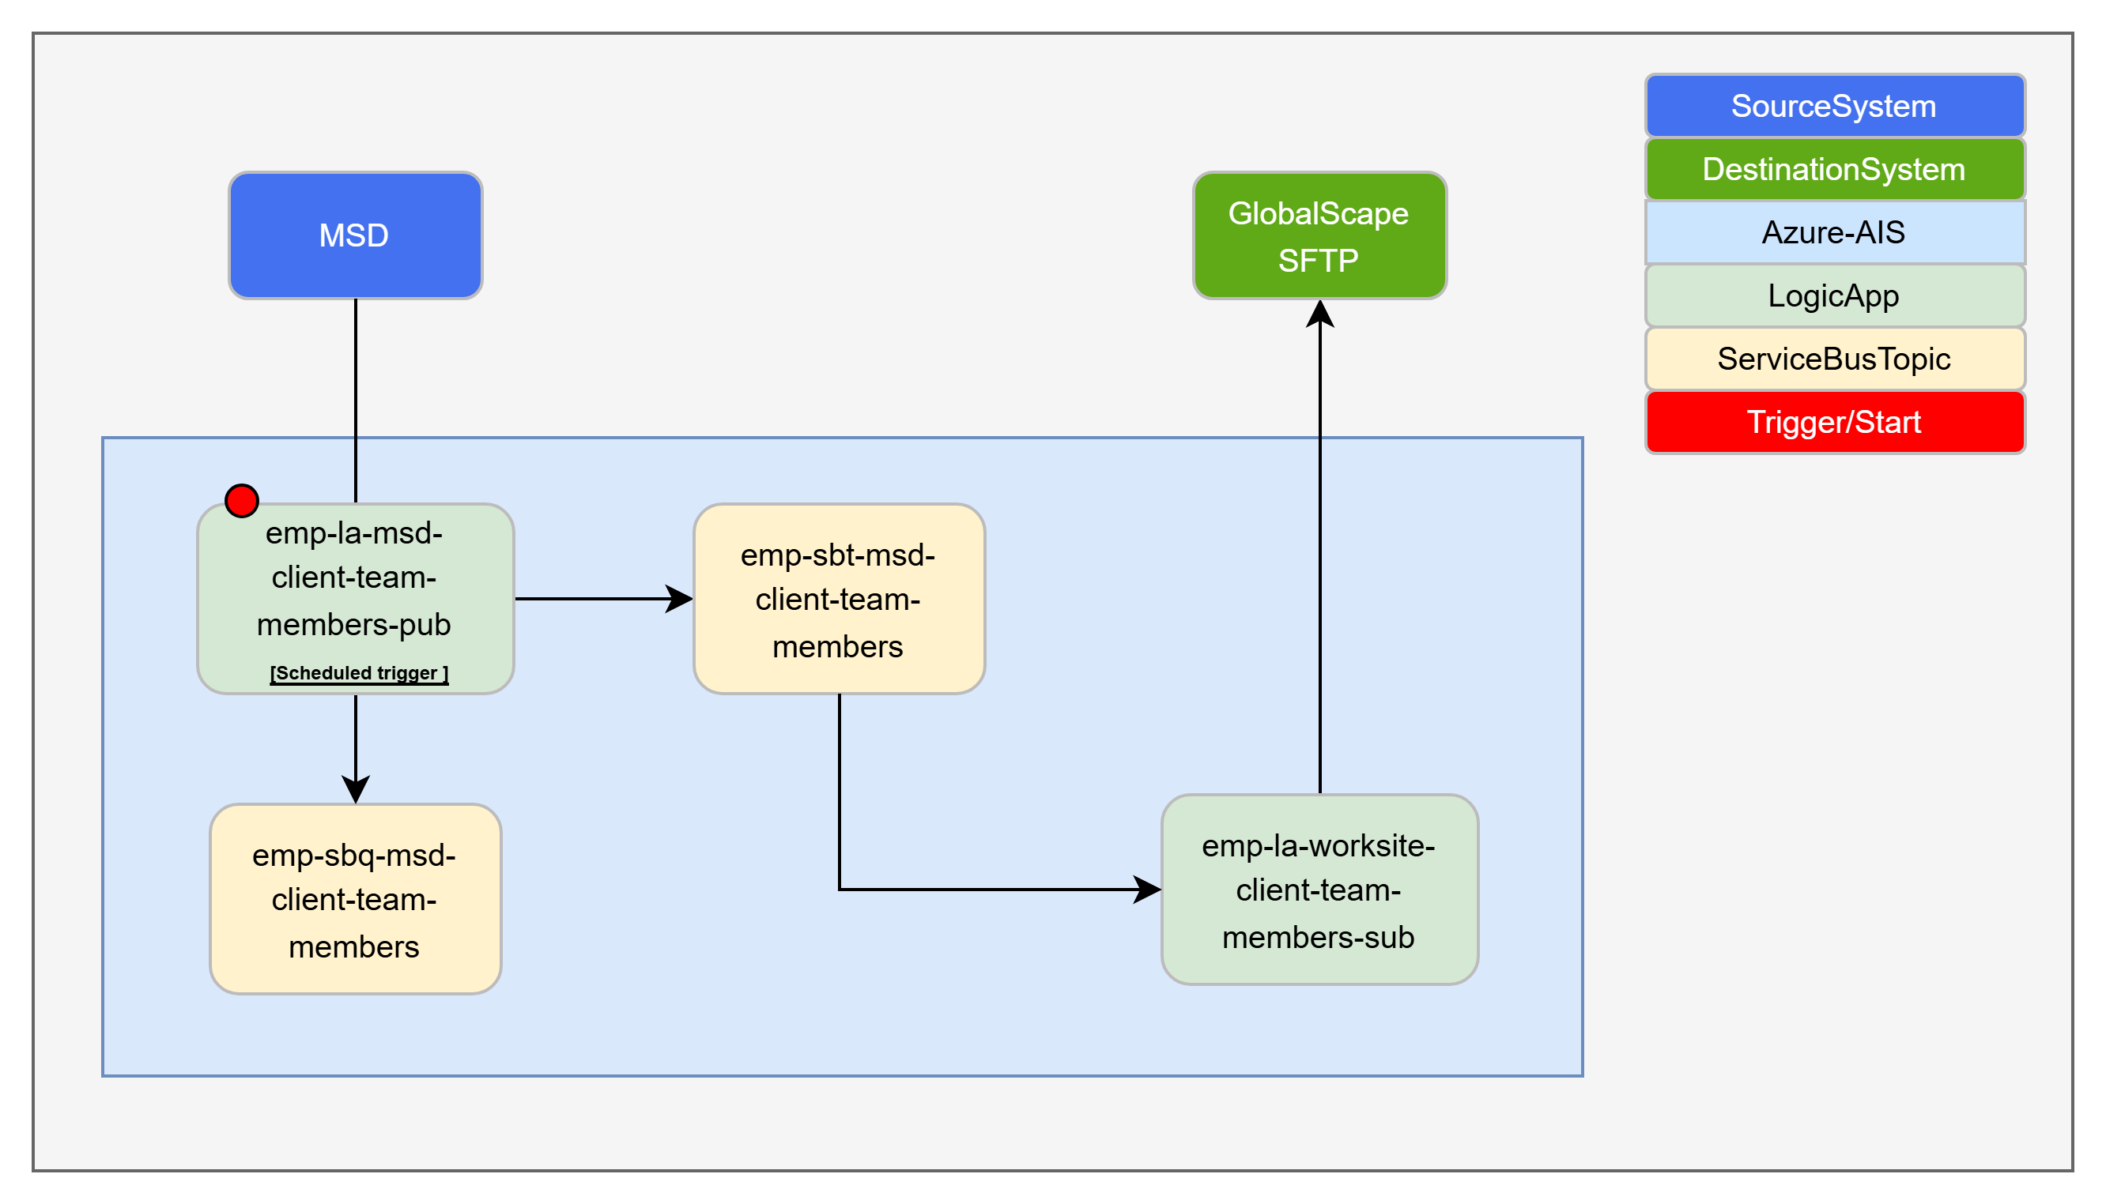
Worksite - TM (Client) – [I0159]
HLD : Conceptual Integration Design - SAP Credit Management Data to SideTrade v0.5.pptx
IDD : IDDD
GIT :

Slide 24
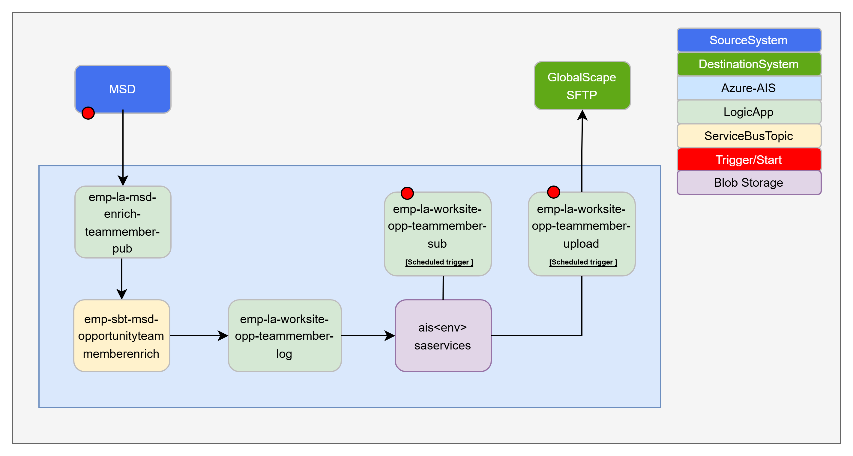
Worksite - TM (Opportunity) – [I0159]
HLD : Conceptual Integration Design - SAP Credit Management Data to SideTrade v0.5.pptx
IDD : IDDD
GIT :

Slide 25

MSD to WorkSite Opportunity Data – [I0159]
HLD : Conceptual Integration Design - MSD to Worksite Opportunity Data.pptx
IDD : IDDD
GIT :

Slide 26
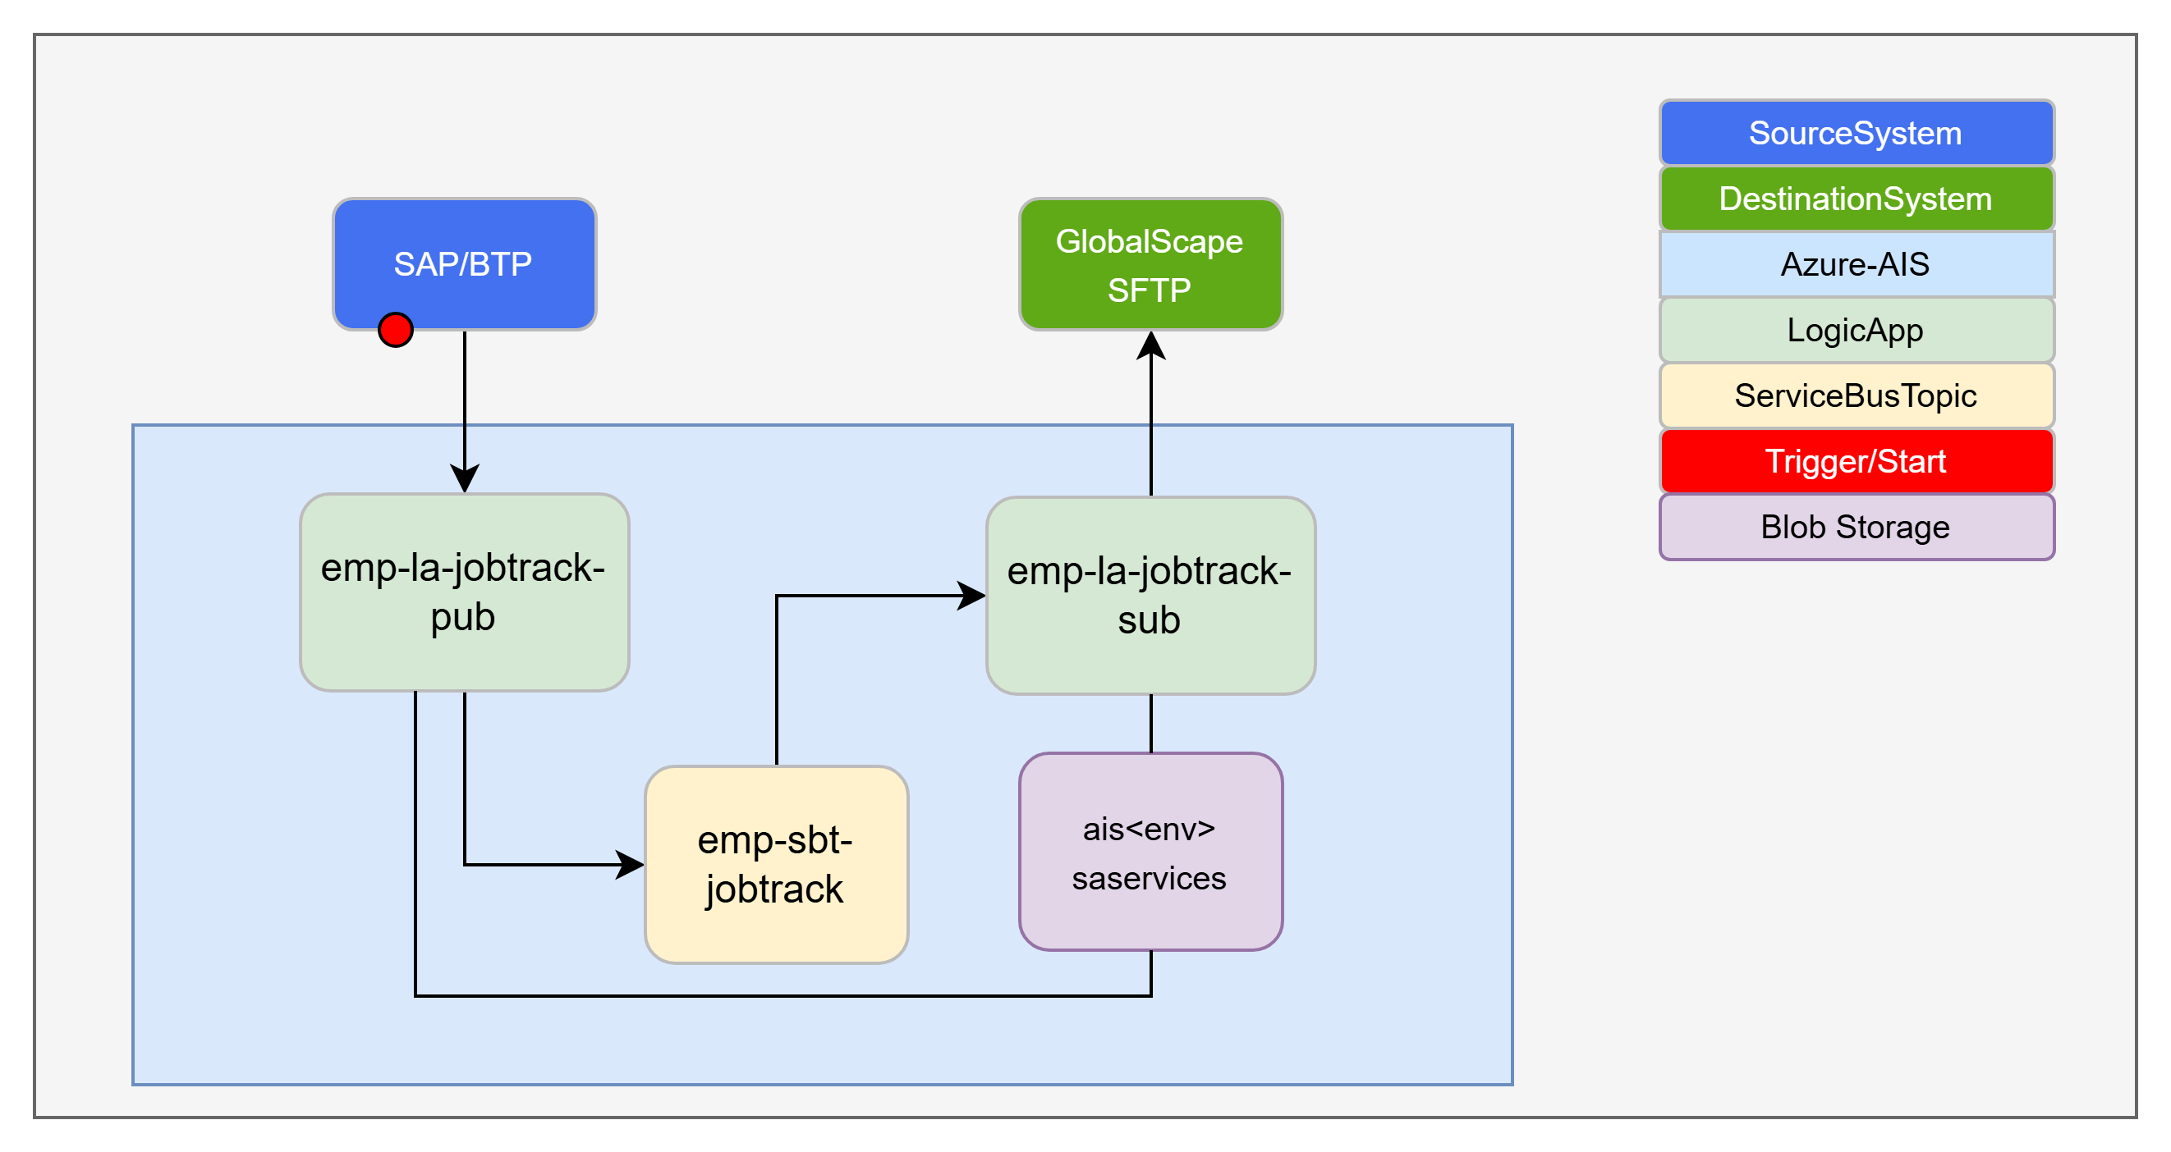
JobTrack Integration – [I0022]
HLD : Conceptual Integration Design - SAP Project Data to JobTrack.pptx
IDD : IDDD
GIT :

Slide 27
Ref-AIS Pub-Sub Solution

Slide 28
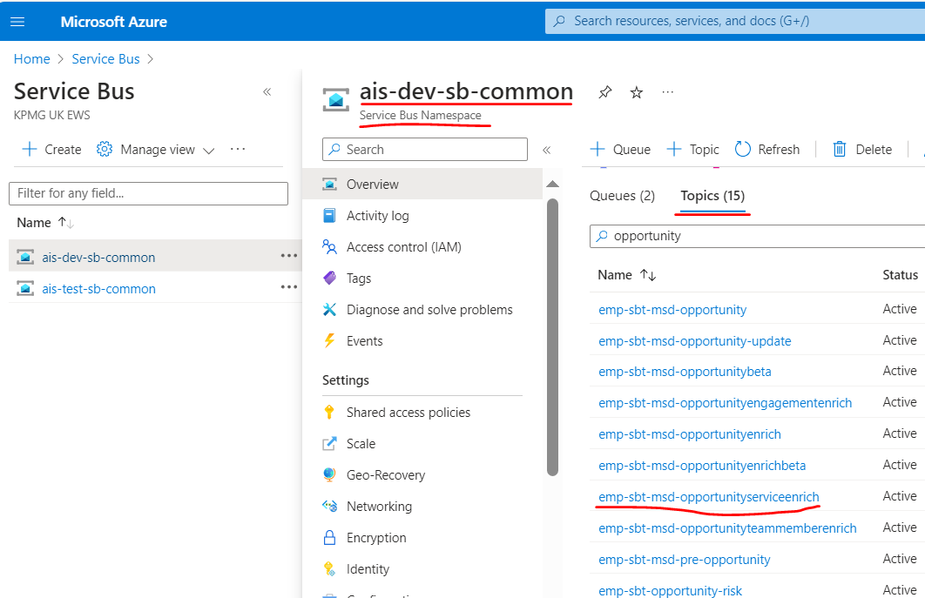
AIS Pub-Sub Solution 1/5
Azure Service-Bus
Topic
Emp-sbt-msd-opportunityenrich
Topic-Subscription
emp-sbs-emp-la-twenty5-opportunity-sub
emp-sbs-emp-la-sap-opportunityproject1-sub
Event-Subscription
emp-egs-msd-twenty5-opportunity
emp-egs-msd-sap-opportunityproject1
LogicApp
emp-la-twenty5-opportunity-sub
emp-la-sap-opportunityproject1-sub

Slide 29
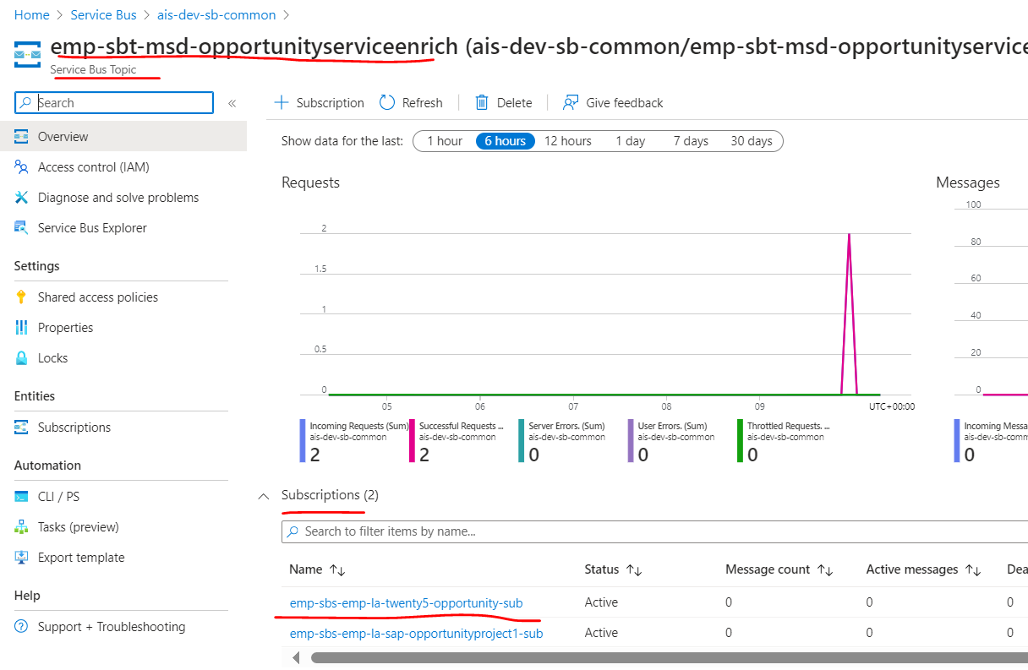
AIS Pub-Sub Solution 2/5
Azure Service-Bus
Topic
Emp-sbt-msd-opportunityenrich
Topic-Subscription
emp-sbs-emp-la-twenty5-opportunity-sub
emp-sbs-emp-la-sap-opportunityproject1-sub
Event-Subscription
emp-egs-msd-twenty5-opportunity
emp-egs-msd-sap-opportunityproject1
LogicApp
emp-la-twenty5-opportunity-sub
emp-la-sap-opportunityproject1-sub

Slide 30
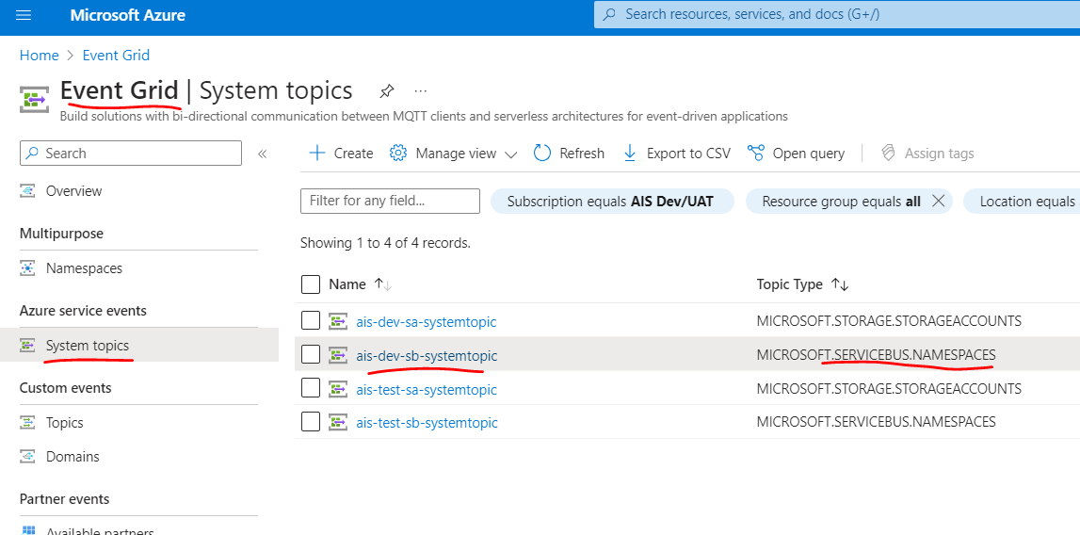
AIS Pub-Sub Solution 3/5
Azure Service-Bus
Topic
Emp-sbt-msd-opportunityenrich
Topic-Subscription
emp-sbs-emp-la-twenty5-opportunity-sub
emp-sbs-emp-la-sap-opportunityproject1-sub
Event-Subscription
emp-egs-msd-twenty5-opportunity
emp-egs-msd-sap-opportunityproject1
LogicApp
emp-la-twenty5-opportunity-sub
emp-la-sap-opportunityproject1-sub

Slide 31
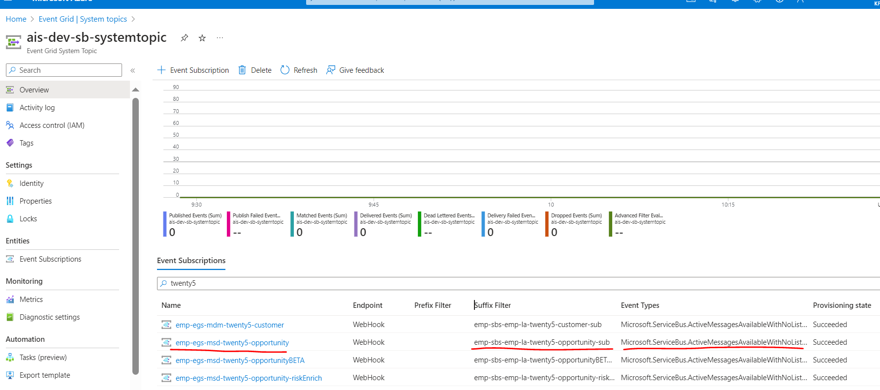
AIS Pub-Sub Solution 4/5
Azure Service-Bus
Topic
Emp-sbt-msd-opportunityenrich
Topic-Subscription
emp-sbs-emp-la-twenty5-opportunity-sub
emp-sbs-emp-la-sap-opportunityproject1-sub
Event-Subscription
emp-egs-msd-twenty5-opportunity
emp-egs-msd-sap-opportunityproject1
LogicApp
emp-la-twenty5-opportunity-sub
emp-la-sap-opportunityproject1-sub

